Slide 1
TALK2MIND
Multimodal AI-Based Mental Well-Being Assessment and Support System
Final Presentation — Internship Project Submission
Submitted By:
Shivam Subedar Patel (Intern, AI/ML)
Organization:
Data Vidwan
Mentor:
Meet Mistry
Date of Submission:
30/06/2026
Python | Computer Vision | NLP | TensorFlow/Keras | OpenCV | Librosa | Streamlit

Slide 2
01
Problem Statement & Objective
The Challenge
Our Approach
Emotional well-being is hard to self-track
Detect facial emotion
Single-modality signals (face or voice alone) are unreliable
Analyze speech emotion
Assess questionnaire responses
Existing tools lack a unified, data-driven score
Fuse results for a Wellbeing Score
Generate personalized recommendations
→
→
→
→
S-1
S-2
S-3
S-4
S-5
Face
Speech
Survey
Fusion
Score
Talk2Mind — Multimodal AI-Based Mental Well-Being Assessment System
2

Slide 3
02
Datasets
Facial Emotion Dataset
Speech Emotion Dataset
FER-2013 / Custom
TESS / RAVDESS
30,000+ labeled images
Audio files in multiple formats
7 emotion classes:
(MP3, OGG, M4A, WAV)
Angry, Disgust, Fear, Happy,
Extracted features:
Sad, Surprise, Neutral
MFCCs, Pitch, Energy
Talk2Mind — Multimodal AI-Based Mental Well-Being Assessment System
3

Slide 4
03
Data Preprocessing & Feature Extraction
Preprocessing Pipeline
Audio formats standardized to WAV in-memory using FFmpeg
Face bounding boxes extracted using OpenCV Haar cascades
1
2
3
Visual
Audio
Subjective
Micro-expression mapping via CNN filters
40-dim MFCC vectors, time-averaged
Weighted 0–4 questionnaire scoring
Late-Fusion Weights: Vision 30% + Audio 30% + Questionnaire 40%
Talk2Mind — Multimodal AI-Based Mental Well-Being Assessment System
4

Slide 5
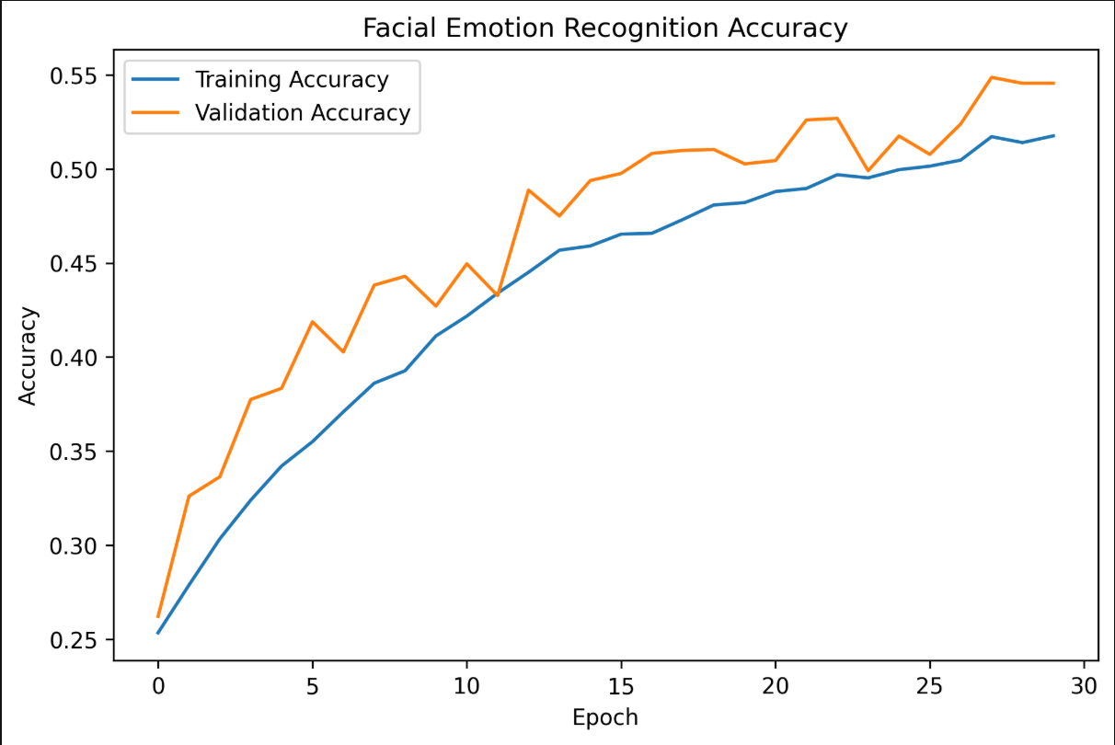
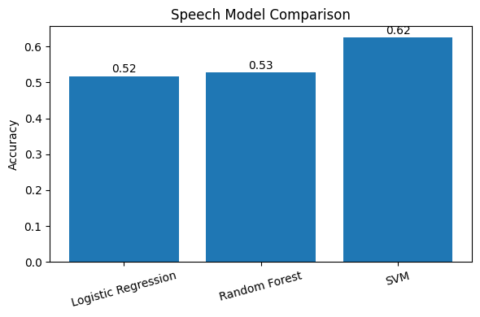
04
Model Training
Facial Models Evaluated
Speech Models Evaluated
MobileNetV2 (Transfer Learning)
Random Forest
Custom CNN
Support Vector Machine (SVM)
Haar Cascades + SVM
Multi-Layer Perceptron (MLP)
Training Notes
StandardScaler applied for consistent inference across acoustic features
Reverse scoring used in the questionnaire to reduce response bias
Training Accuracy / Loss Curve — Face Model
Training Accuracy / Loss Curve — Speech Model
Insert Screenshot Here
Insert Screenshot Here
Talk2Mind — Multimodal AI-Based Mental Well-Being Assessment System
5

Slide 6
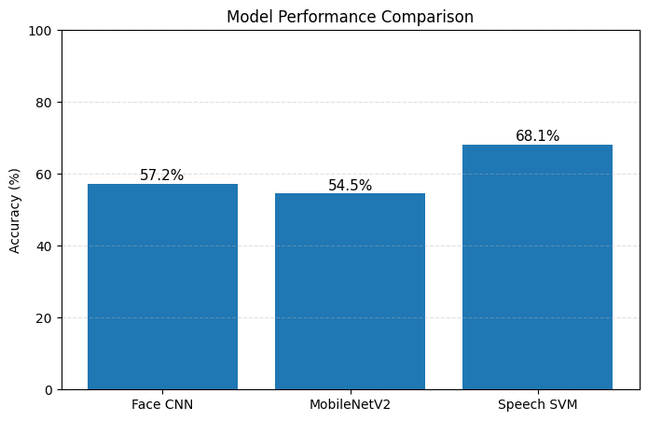
05
Model Comparison
Illustrative results — replace with final benchmarked accuracies
Model
Modality
Accuracy
CNN (Face)
Facial
57.2%
MobileNetV2
Facial
54.1%
Logistic Regression
Speech
51.7%
Random Forest
Speech
52.8%
SVM (Speech)
Speech
68.1%
Model Comparison Chart
Insert Screenshot Here
Talk2Mind — Multimodal AI-Based Mental Well-Being Assessment System
6

Slide 7
06
Final Architecture
Camera
→
Face CNN
→
Detected Emotion
Fusion
Engine
Microphone
→
Feature Extraction
→
SVM
→
Detected Emotion
↓
Wellbeing Score
Questionnaire
→
Scoring Logic
→
Self-Report Result
↓
Recommendations
Talk2Mind — Multimodal AI-Based Mental Well-Being Assessment System
7

Slide 8
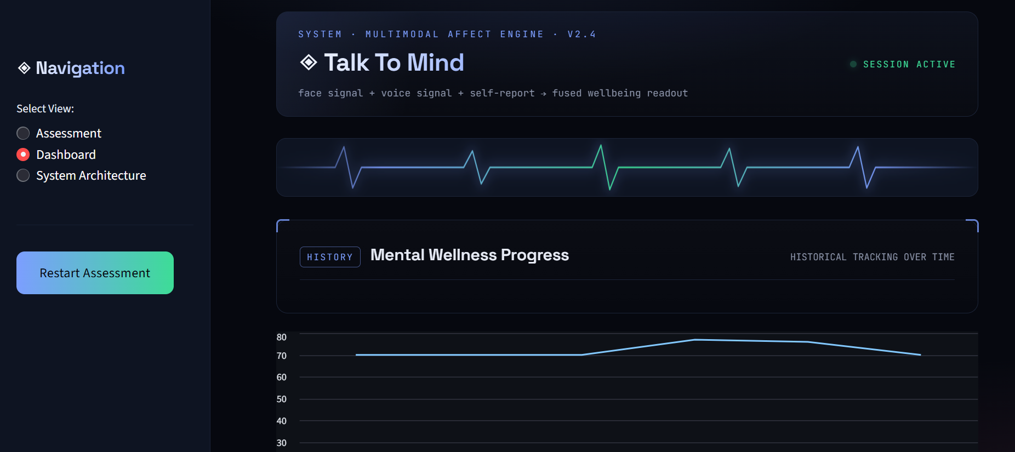
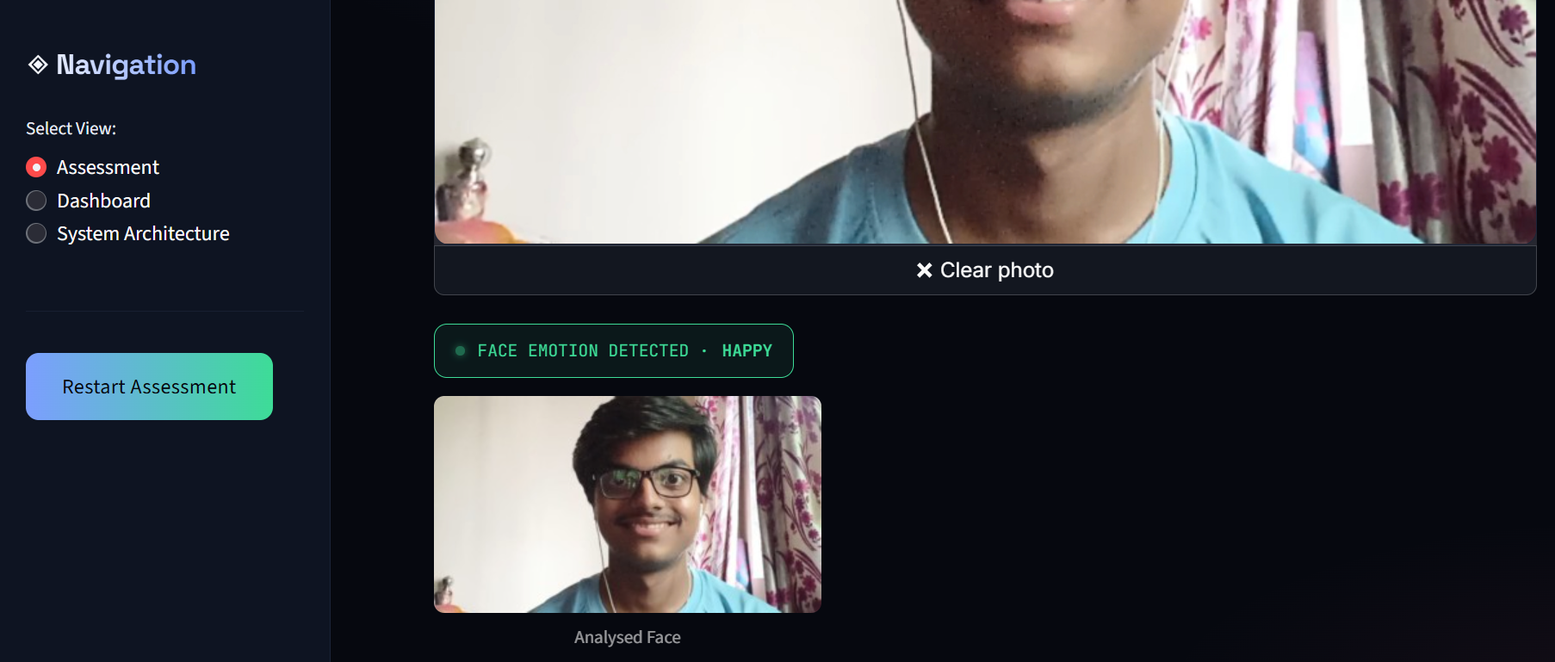
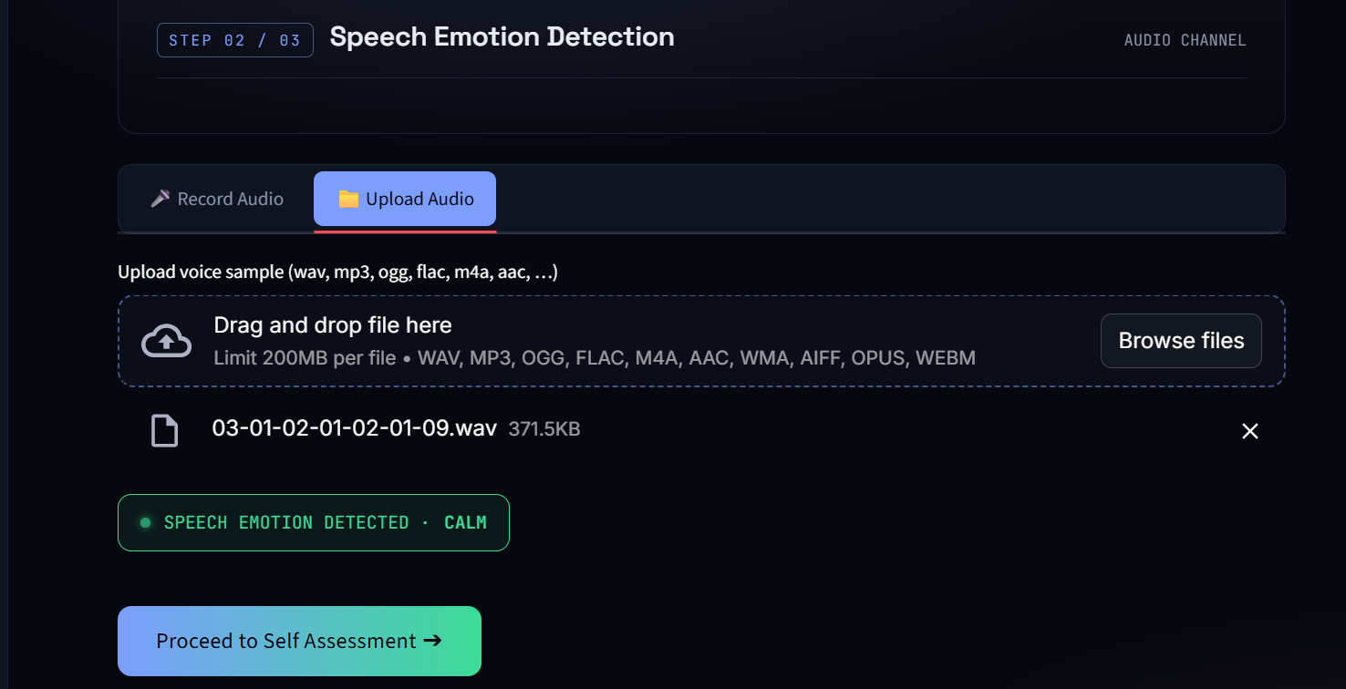
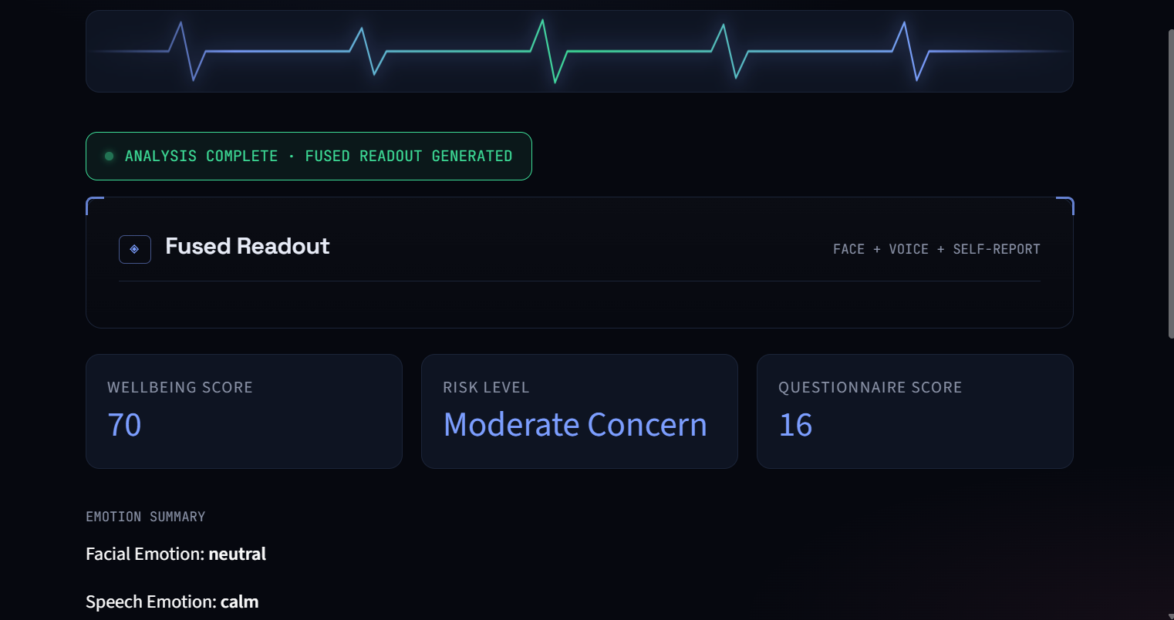
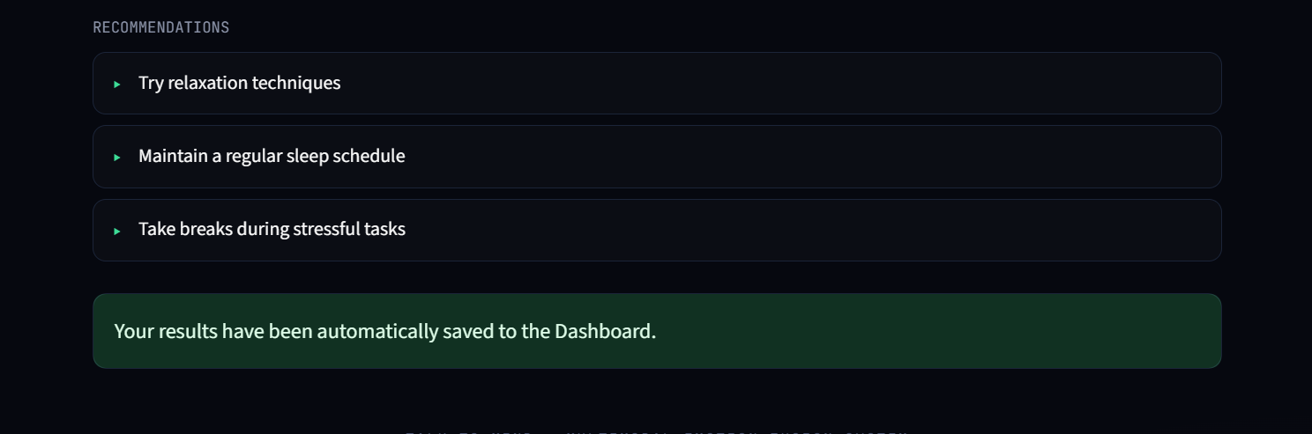
07
Dashboard Demo
Built in Streamlit — dashboard/app.py — the “Neural Diagnostics Console”
Talk2Mind — Multimodal AI-Based Mental Well-Being Assessment System
8

Slide 9
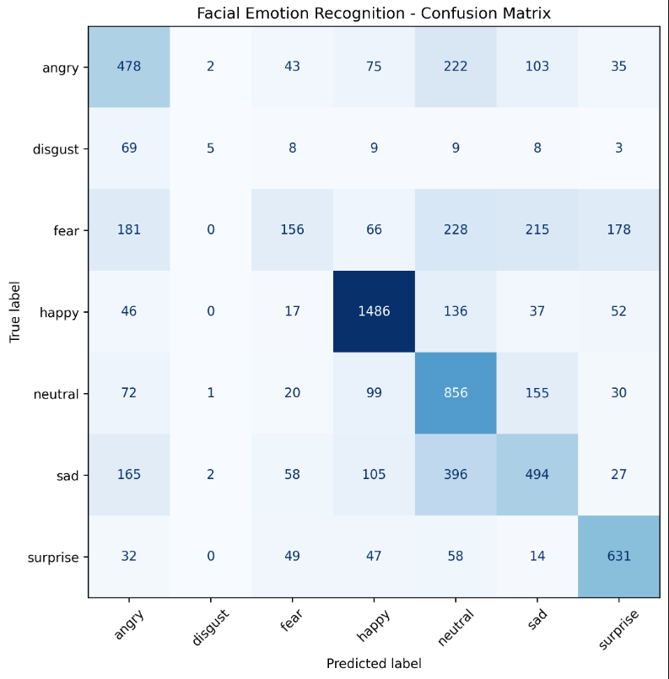
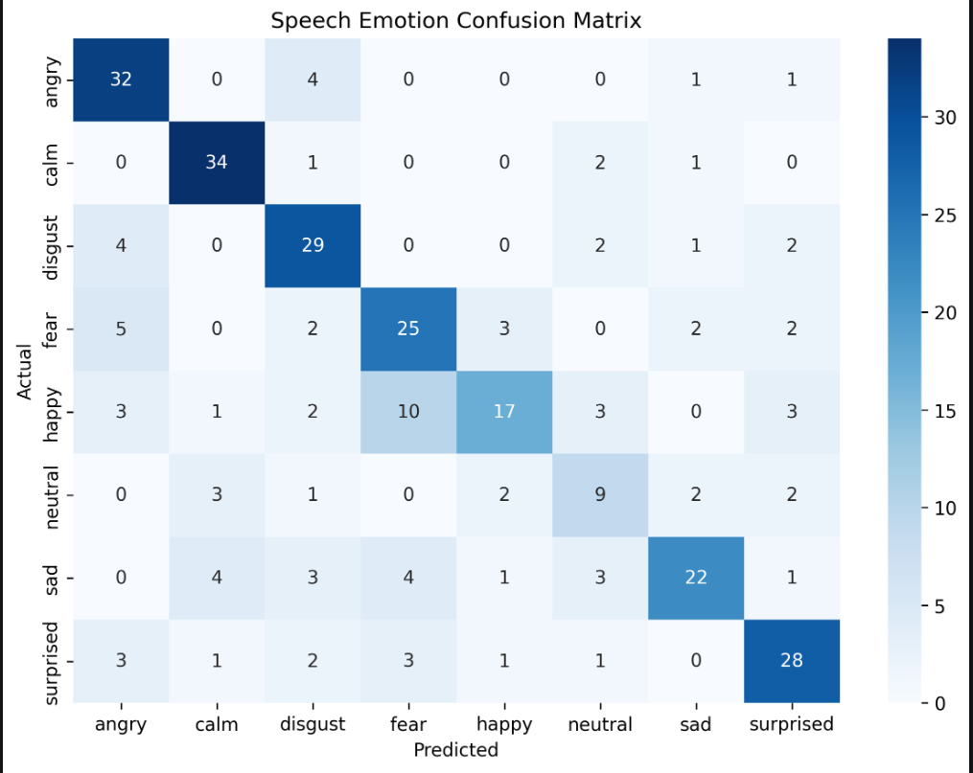
08
Results
Key Findings
Late-fusion weighting outperformed single-modality evaluation
Questionnaire stabilizes variant facial/acoustic predictions
SVM with MFCCs matched heavy RNNs, with faster inference
CNN Confusion Matrix
SVM Confusion Matrix
Model Comparison Chart
Insert Screenshot Here
Insert Screenshot Here
Insert Screenshot Here
Talk2Mind — Multimodal AI-Based Mental Well-Being Assessment System
9

Slide 10
09
Delivered Modules & Future Scope
Module Status
Limitations
Facial Emotion Recognition
✓
Speech model relies strictly on MFCCs
Speech Emotion Recognition
Recommendations are rule-based, not LLM-driven
✓
Mental Health Questionnaire
✓
Future Scope
Mobile app integration
Fusion Engine
✓
Clinical validation
Progress Tracking
✓
Transformer-based speech models
Streamlit Dashboard
✓
Real-time webcam monitoring
Multilingual speech support
Talk2Mind — Multimodal AI-Based Mental Well-Being Assessment System
10

Slide 11
Conclusion
End-to-end multimodal ML solution for mental well-being assessment
Combines facial, speech, and self-report signals via Weighted Late-Fusion
Minimizes blind spots of single-modality AI
Delivers immediate, data-driven insights through an interactive dashboard
Provides a clear path to track mental health progress over time
pip install -r requirements.txt
cd dashboard && streamlit run app.py
Thank You
Talk2Mind — Multimodal AI-Based Mental Well-Being Assessment System
11

